Slide 1

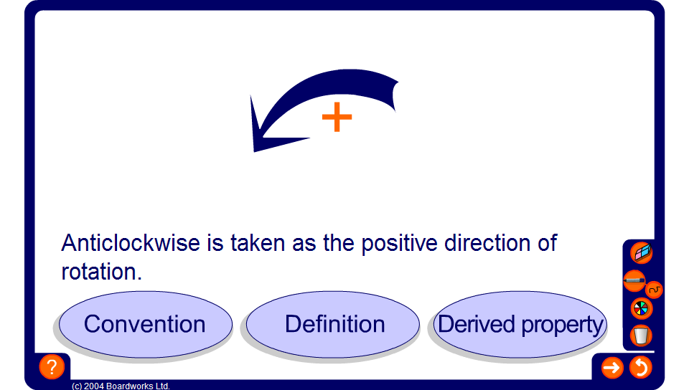


Convention, definition or derived property?
Notes:
Decide whether the information given is a convention, a definition or a derived property.

